Slide 1


Slide 2
Objective
Study 2-to-4 line decoders
Implement 3-to-8 line decoder using 2-to-4 line decoders
Realizing combinational circuits using decoder
F = M₁ . M₃ . M₆ . M₇
CSE 226: Digital Logic Design Lab

Slide 3
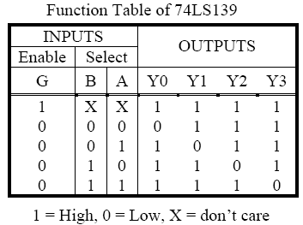
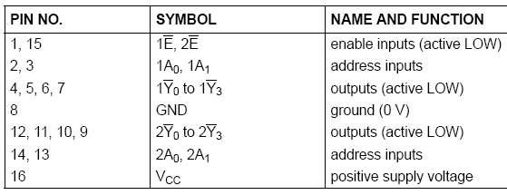
74139 dual 2-to-4 decoder
CSE 226: Digital Logic Design Lab

Slide 4
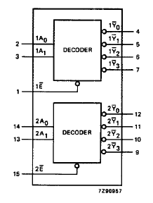
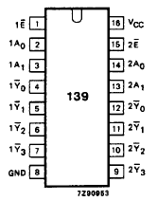
Functional Diagram
CSE 226: Digital Logic Design Lab

Slide 5
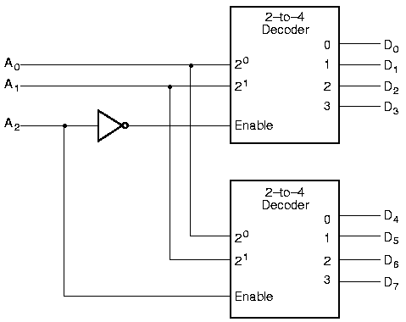
What to do
Using 74139 implement a 3-to-8 line decoder
We have seen in theory, how to do that
CSE 226: Digital Logic Design Lab

Slide 6
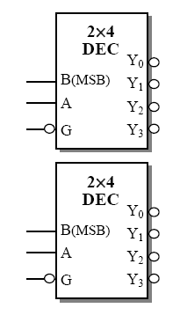
Implement a 3-to-8 line decoder
Following that pattern complete this connection using 74139, note the pin numbers
CSE 226: Digital Logic Design Lab

Slide 7
Realizing combinational circuits
Active-low decoders generate maxterms.
If you have a product of maxterms equation for a function, you can easily use a active-low decoder and AND gates to implement that function.
CSE 226: Digital Logic Design Lab

Slide 8
Writing Report
Description of 74139 (truth table, pin diagram, gate diagram)
Logic diagram of 3-to-8 line decoder implementation
Logic diagram of realizing combinational circuits using 3-to-8 line decoder
F = M₁ . M₃ . M₆ . M₇
Answer the question:
  How to use the 3-to-8 line decoder (the one you have designed) for implementing combinational circuits of sum of minterms
F = m₁ + m₃ + m₆ + m₇
CSE 226: Digital Logic Design Lab

